Slide 1
Estimating sample size

Slide 2
content
Point estimation
Standard error of the Mean
Confidence Interval
Sample size estimation

Slide 3
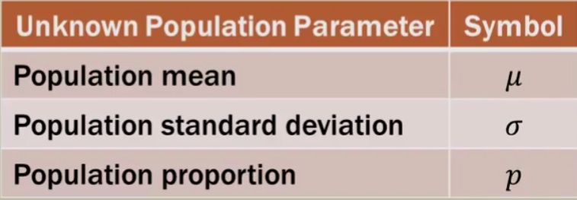
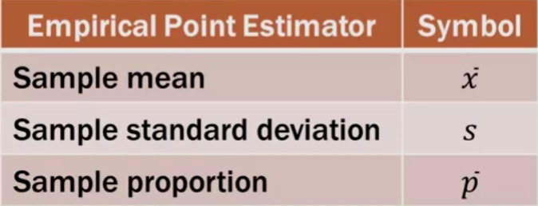
Point estimation
.
The sample statistics (see figure 2) are commonly referred to as Point Estimator for unknown population parameter.
Point estimators have always an error. These errors are commonly referred to as ‘margin of error’.
Figure 1
Figure 2

Slide 4
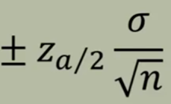

Margin of error: definition
The margin of error is statistic expressing the amount of random sampling error in a surveys results.
The larger the margin of error, the less confidence one should have that the reported results are close to the true figures. Margin of error applies when a population is incompletely sampled.

Slide 5
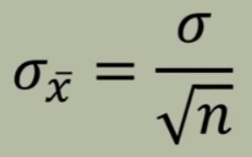
Standard Error of the Mean (SEM)
Standard Error of the Mean (Standard deviation of mean): SEM
Standard deviation of Population
Sample size
Relationship between SEM, Standard deviation of the population and Sample size: When sample size increases, SEM decreases (arrows) and when population standard deviation is small, SEM also tends to be small.

Slide 6
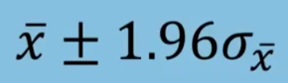
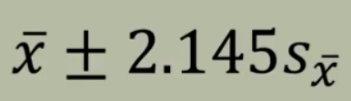
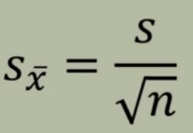
Confidence Interval
Confidence Interval = Point Estimate ± Margin of error
Confidence Interval = Point Estimate (mean) ± 1.96σ$\frac{}{x}$
Confidence Interval =
When population standard deviation is known
Confidence Interval =
When population standard deviation is NOT known
t distribution (degrees of freedom)

Slide 7
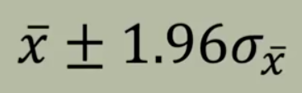
Example 1
To estimate the mean amount spent per customer at CNR wet canteen, data was collected for 75 students that are randomly chosen. Assume that population standard deviation is Nu. 4.
At 95% confidence level, what is the margin of error?
If the sample mean is Nu. 20, what is the 95% confidence interval for the population mean?
σ
n
z (value at 95%)

Slide 8
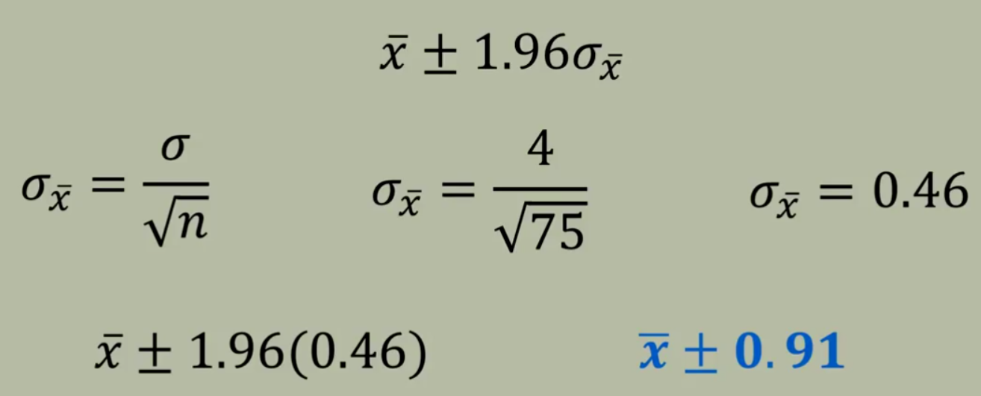
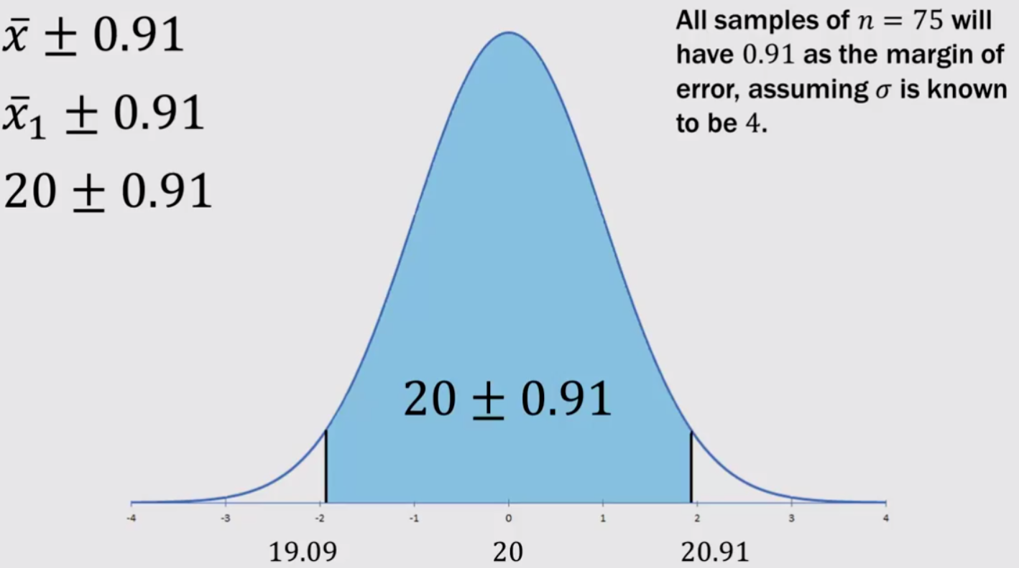
Solution
Formula to calculate Sample standard deviation

Slide 9
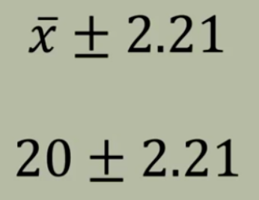
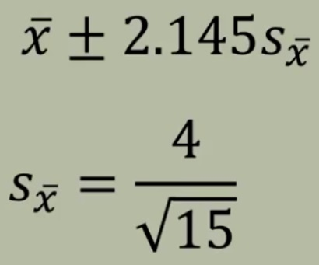



Exercise 2
To estimate the mean amount spent per customer at CNR wet canteen, data was collected for 15 students randomly chosen with sample mean of Nu. 4.
At 95% confidence level, what is the margin of error?
If the sample mean is Nu. 20, what is the confidence interval for the population mean ( for all the students)?
n =
s =
df =

Slide 10
Remember
When Population Standard Deviation is known use z distribution (±1.96) to determine margin of error while estimating Confidence Interval.
When Population Standard Deviation is not known (for example, small sample or rare) use t distribution (± 2.26) to determine margin of error while estimating Confidence Interval.

Slide 11
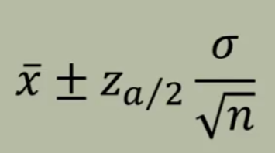
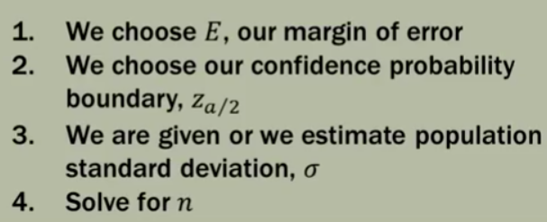
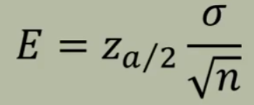
Estimating sample size (n)
Substitute Margin of error by ‘E’

Slide 12
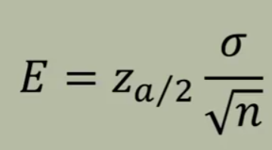
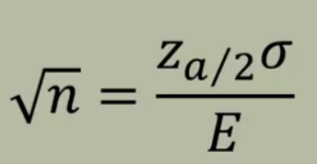
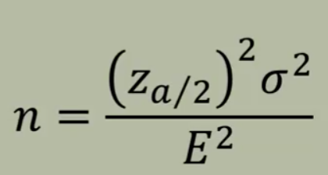
Rearrange algebraically
Square both sides to eliminate square root
Now solve for the sample size ‘n’ using other measures

Slide 13
Note for selecting sample size
Standard deviation (Population Standard Deviation) is required to estimate sample size but most of the time Population Standard Deviation is not known. So use following options:
Estimate σ from the previous studies using the same population of interest.
Conduct a pilot study to select a preliminary sample and use sample standard deviation from the pilot study.
Use a judgment or ‘best guess’ for σ. A common guess is the data range (high – low) divided by 4 (This is also called a ‘planning value’).

Slide 14
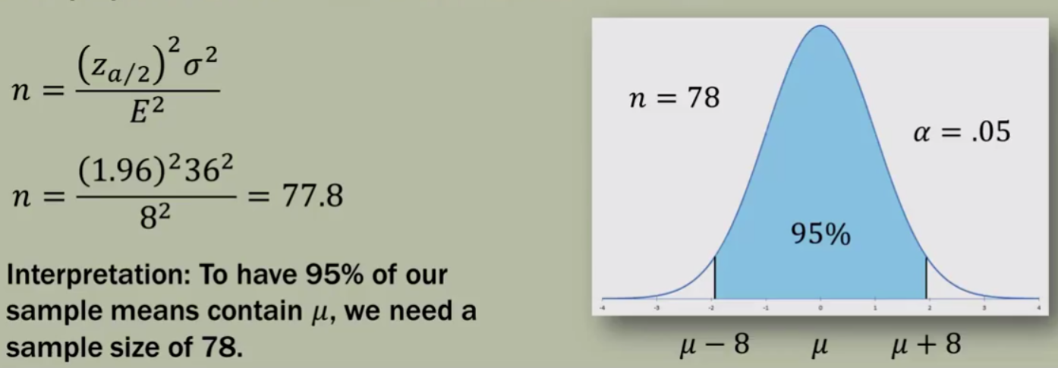
Example 3
How large a sample size should be selected to provide a 95% confidence interval with a margin of error (E) of 8, assuming the population standard deviation is, σ, = 36?

Slide 15
Exercise 4
A grocery shop place an order for rice bags for selling with a minimum of 782 and a maximum of 1303 bags per day. When minimum bags were ordered there was shortage but if the maximum were ordered some bags were getting spoilt. A 95% confidence interval is desired. Determine:
A planning value for the population standard deviation.
How large a sample of rice bags per day should be ordered with the following margin of errors: (a) ±100, (b) ± 50, (c) ± 30

Slide 16
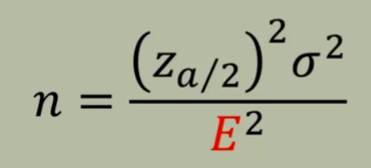
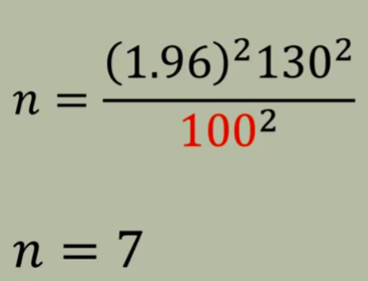
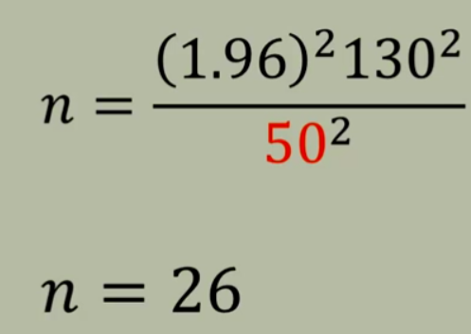
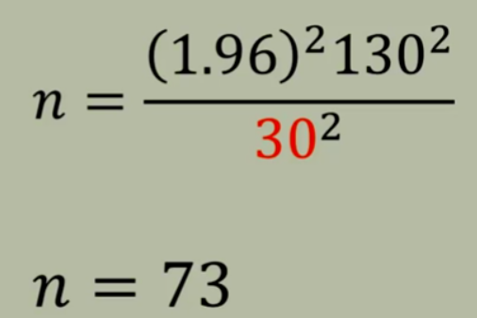
Sample size versus Margin of error

Slide 17
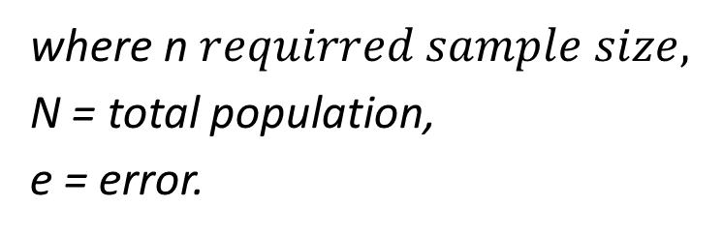

Example 1 (additional formula for calculating sample size)
Lets say we want to do a survey of employee of CNR on how they use computers at work. Lets say the total population is 2500 and if the level of your confidence is 95%, what would be the sample size you need to consider a sample for data collection?
n $=\frac{N}{1+Ne^{2}}$
where n $requirred sample size,$
N = total population,
e = error.

